Slide 1
Linux Commands

Slide 2
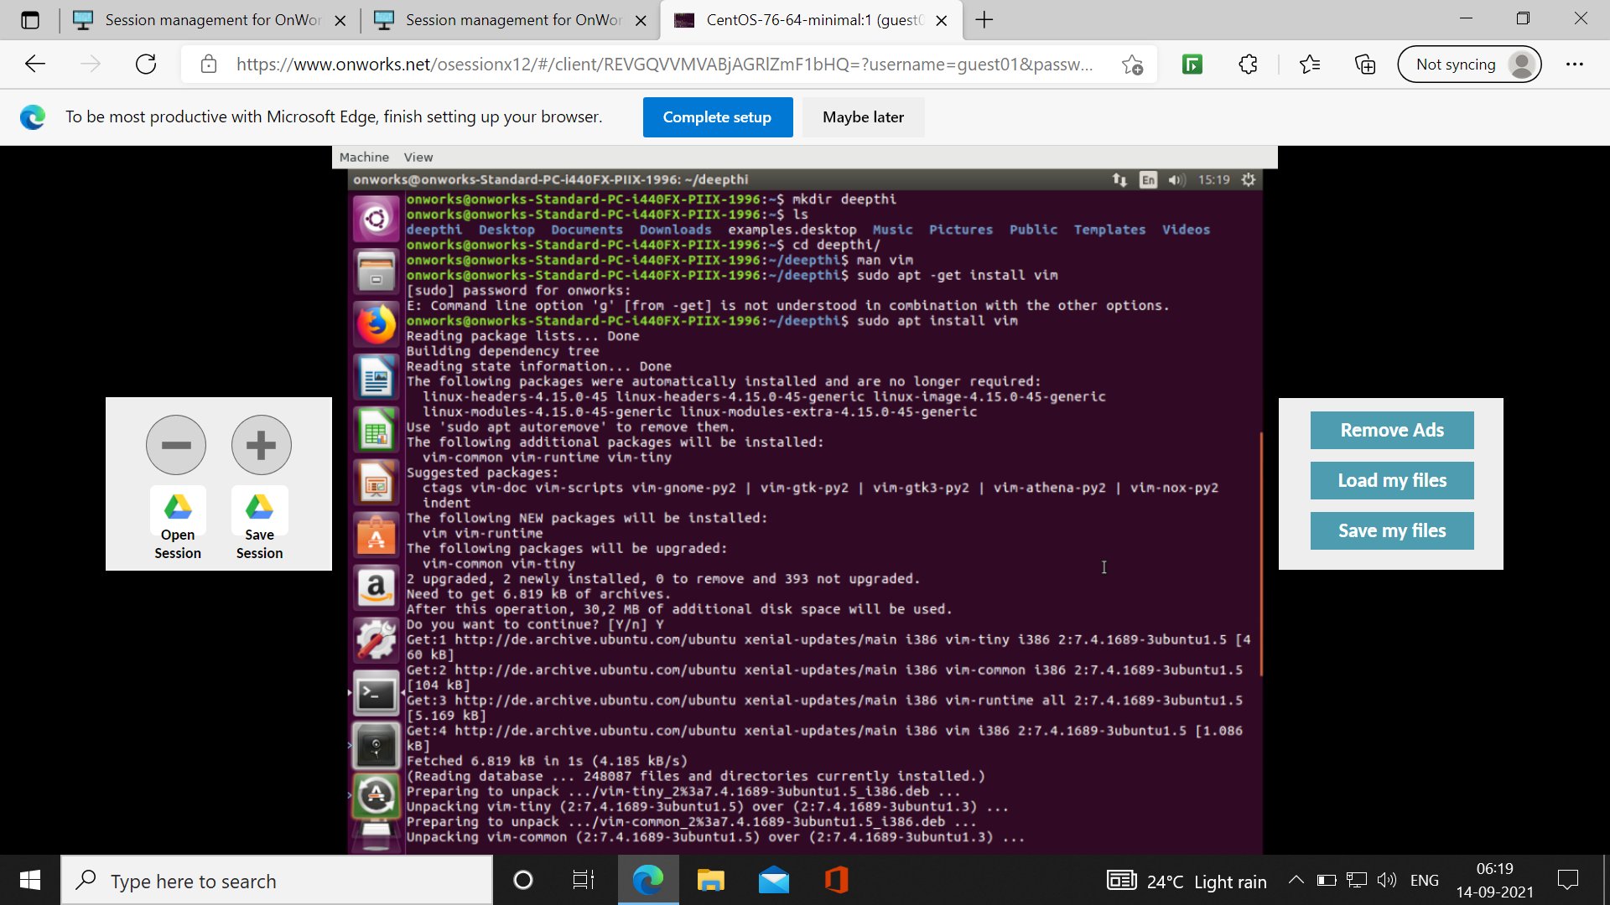

Slide 3
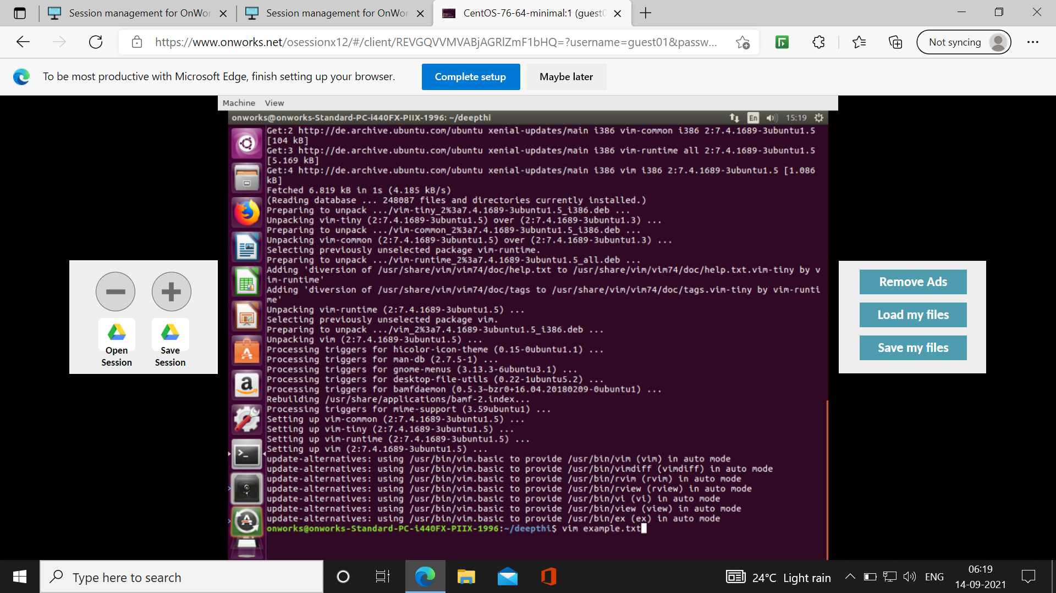

Slide 4
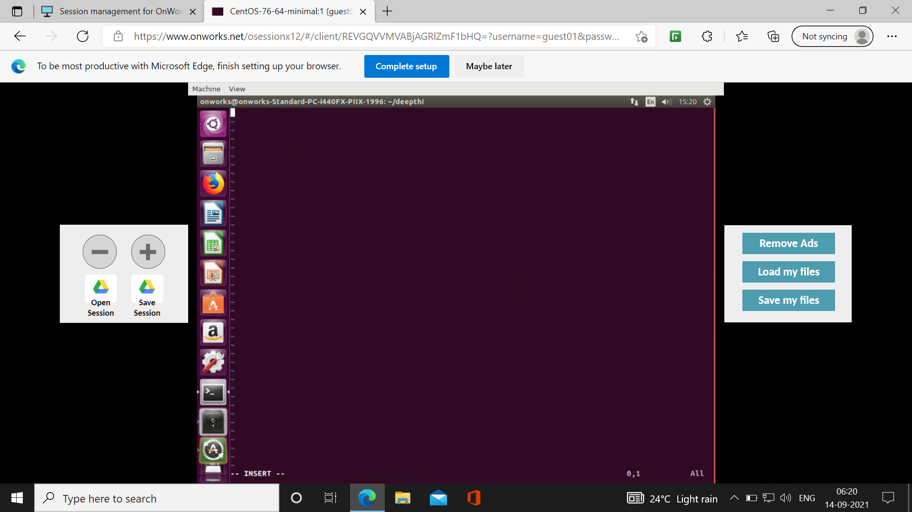
After pressing I command. It will enter into the editor mode

Slide 5
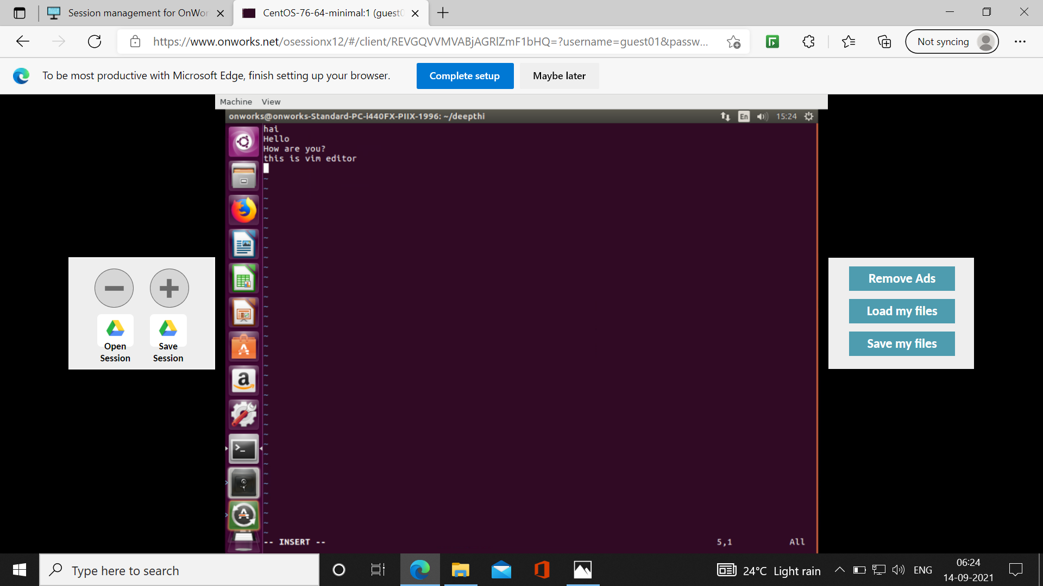

Slide 6
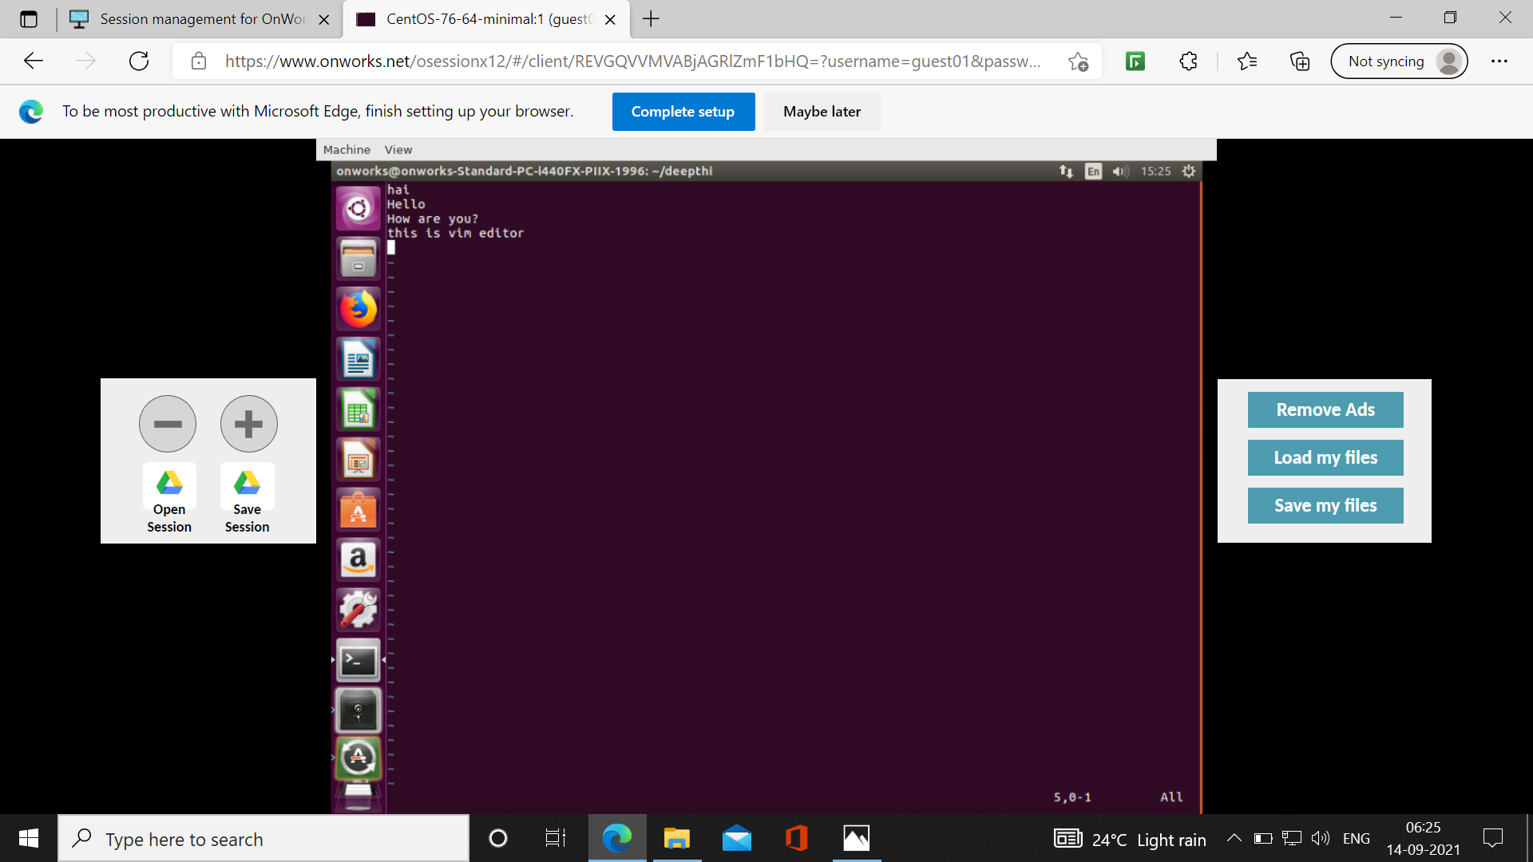
After pressing Escape command, it will come back the command mode

Slide 7

Set number command

Slide 8

After pressing dd command. The first line is deleted

Slide 9
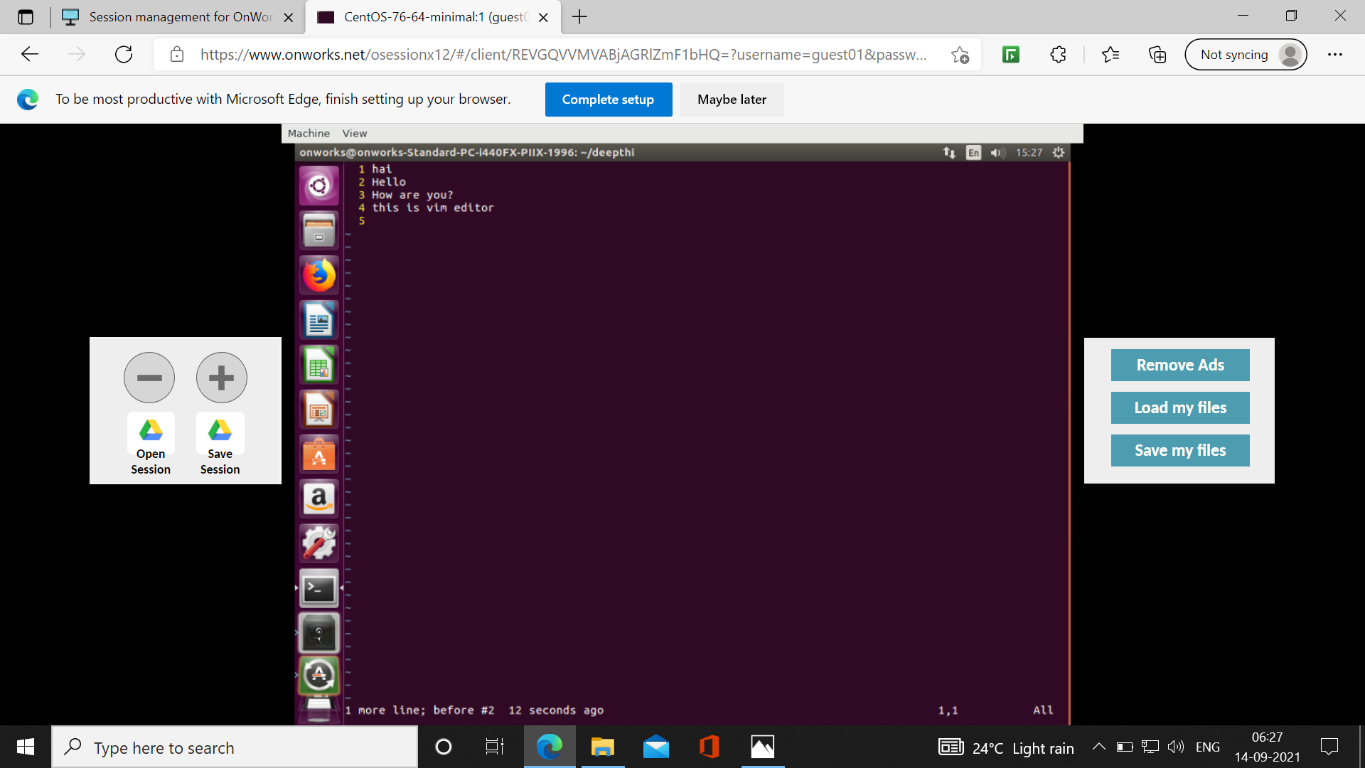
After pressing u command, the deleted first line is come back

Slide 10
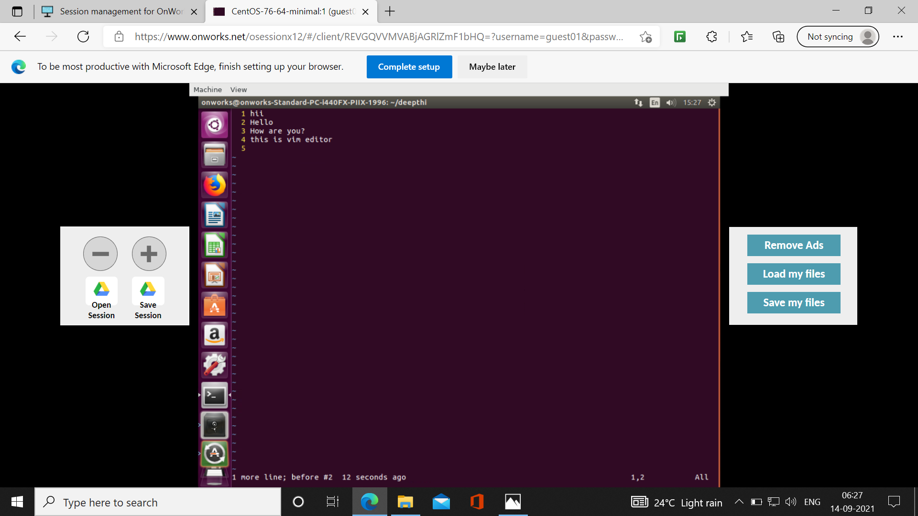
After pressing r command, in the first line a is replaced with i

Slide 11

After pressing e, the cursor is going to the end of the word this in the line 4

Slide 12

After pressing x, in the first line letter I is deleted

Slide 13
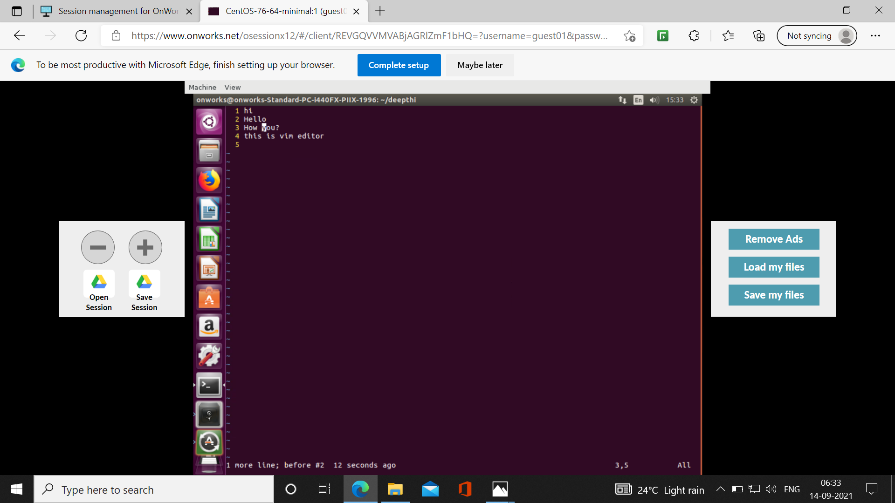
Pressing dw, the word are in the third line is deleted

Slide 14

Undo u

Slide 15

Redo ctrl+r

Slide 16
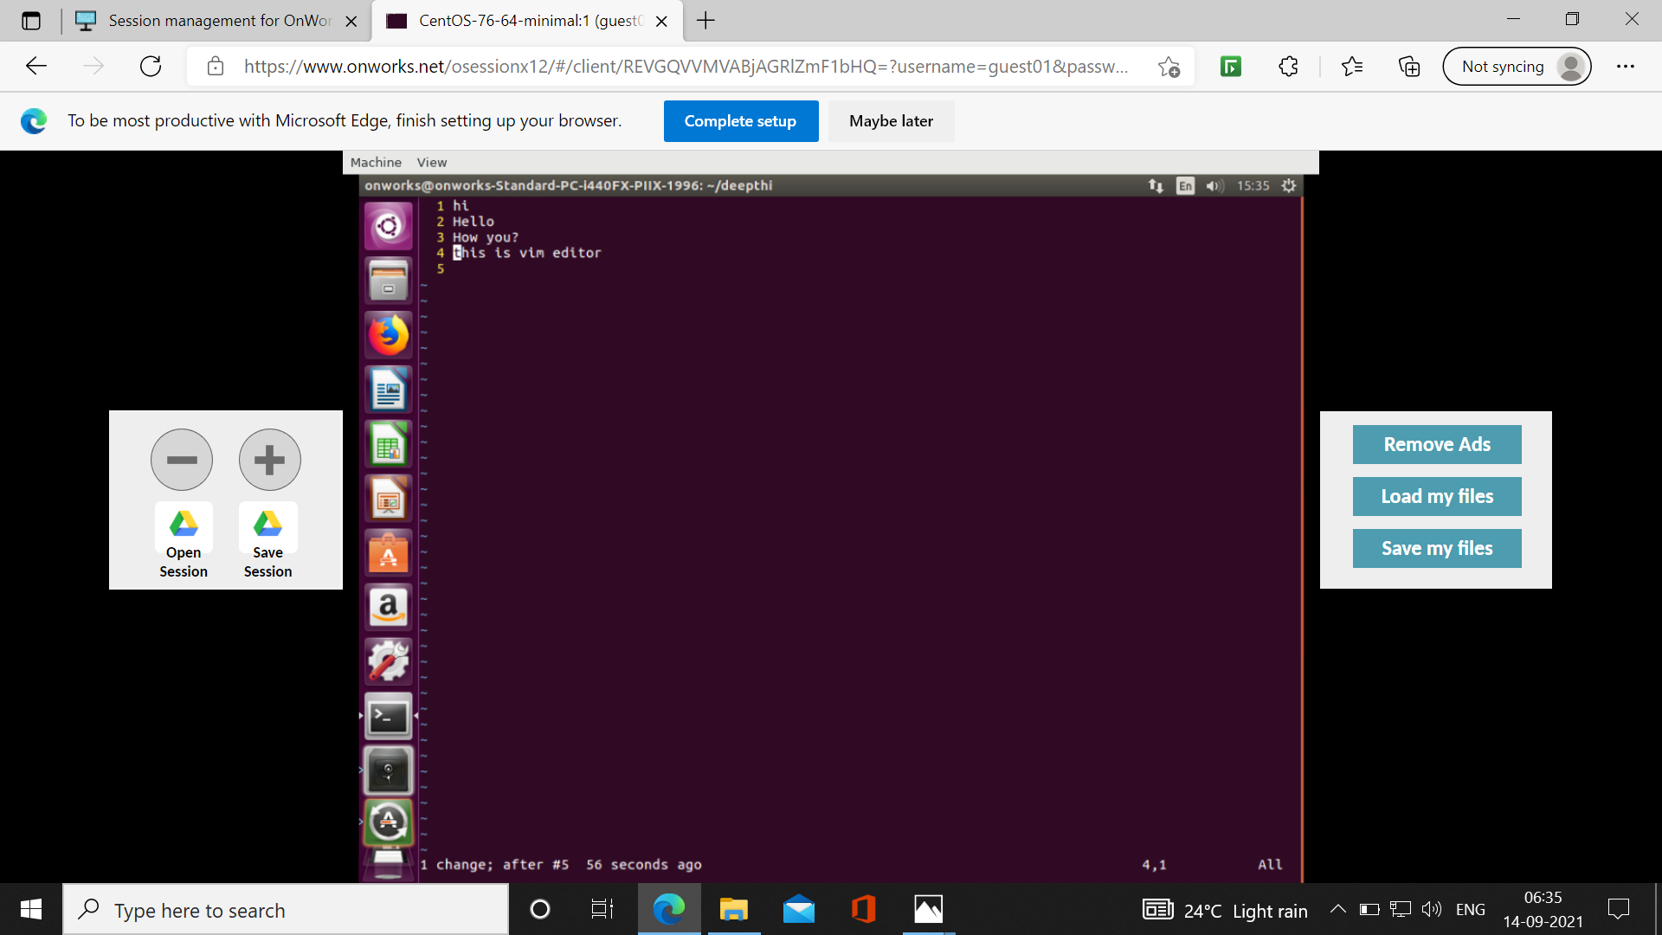
While pressing yy, it copy the entire fourth line

Slide 17
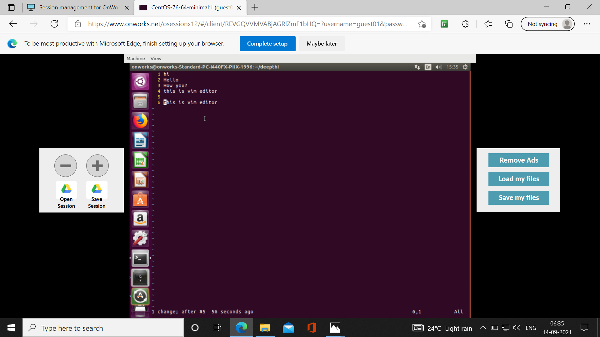
While pressing p, it paste the copied content to line number 6

Slide 18

While giving d3, it will delete the first 3 lines

Slide 19

While giving :wq, it will save the content in the file and come out of the command mode

Slide 20
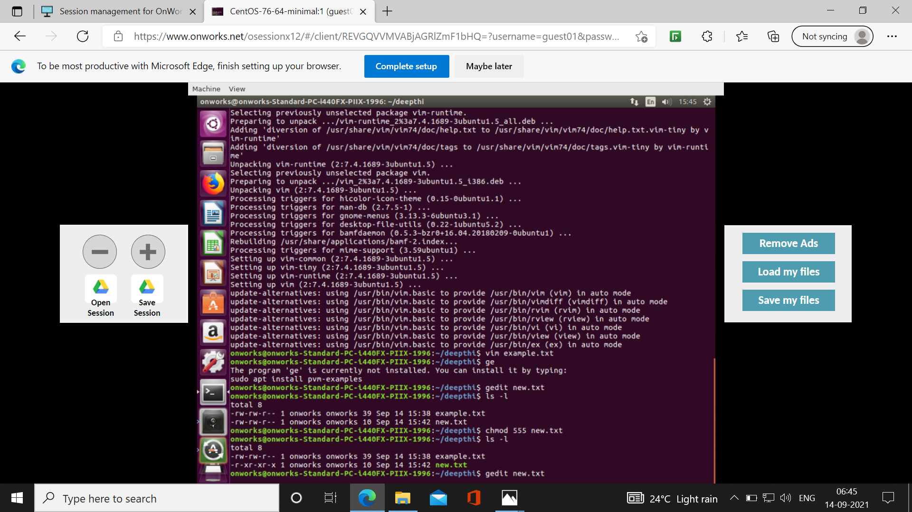

Slide 21
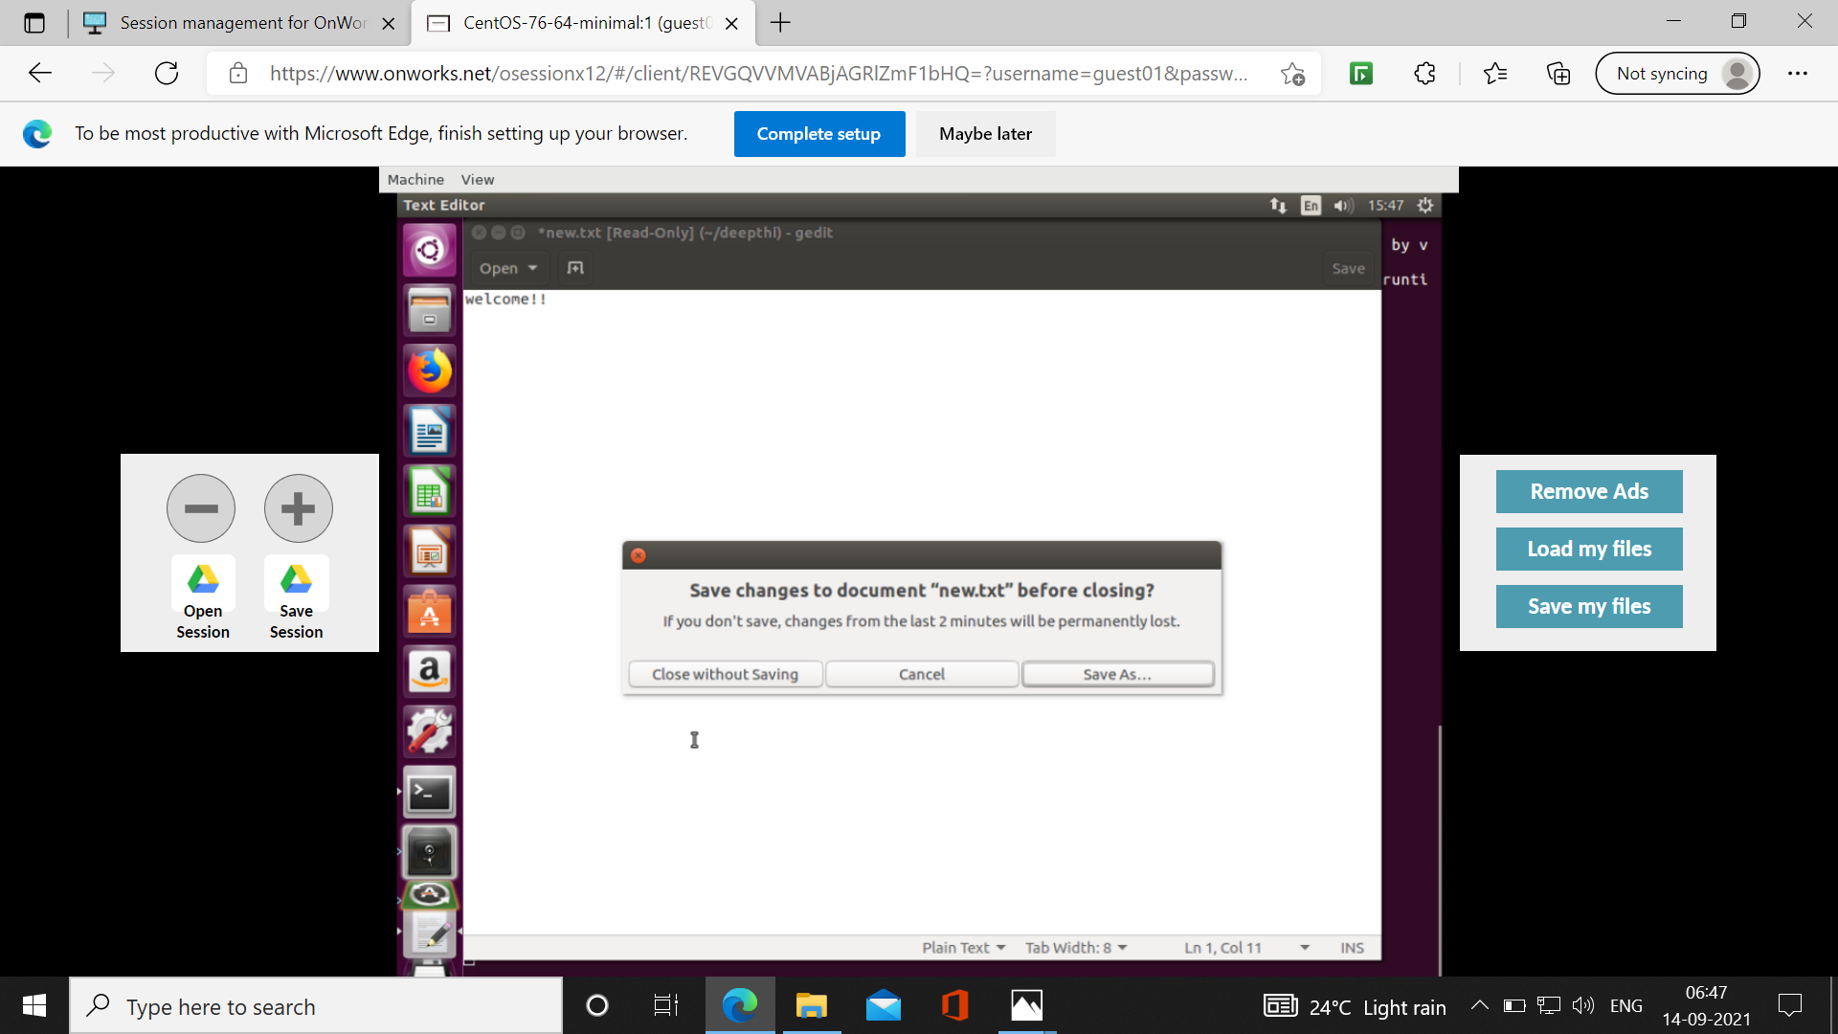

Slide 22


Slide 23
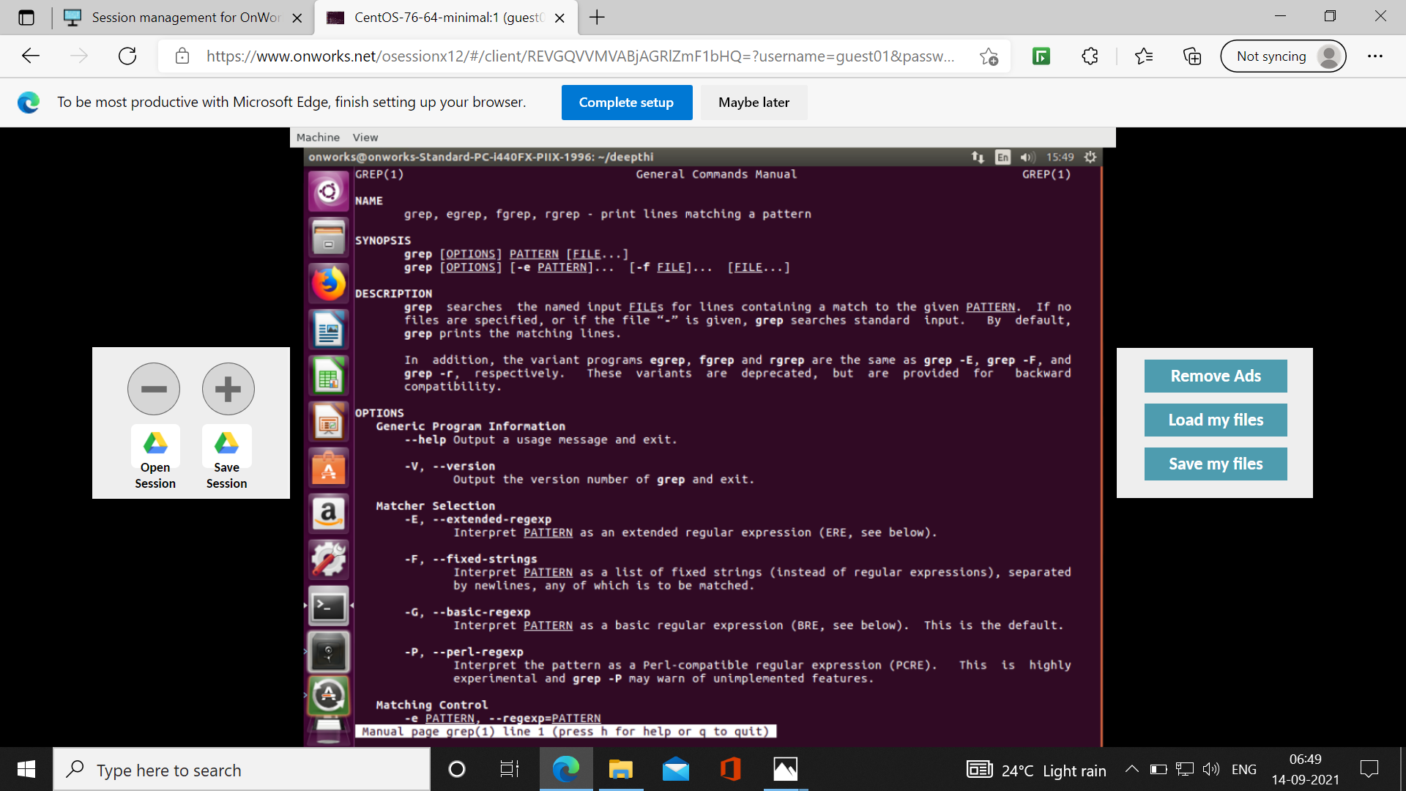

Slide 24
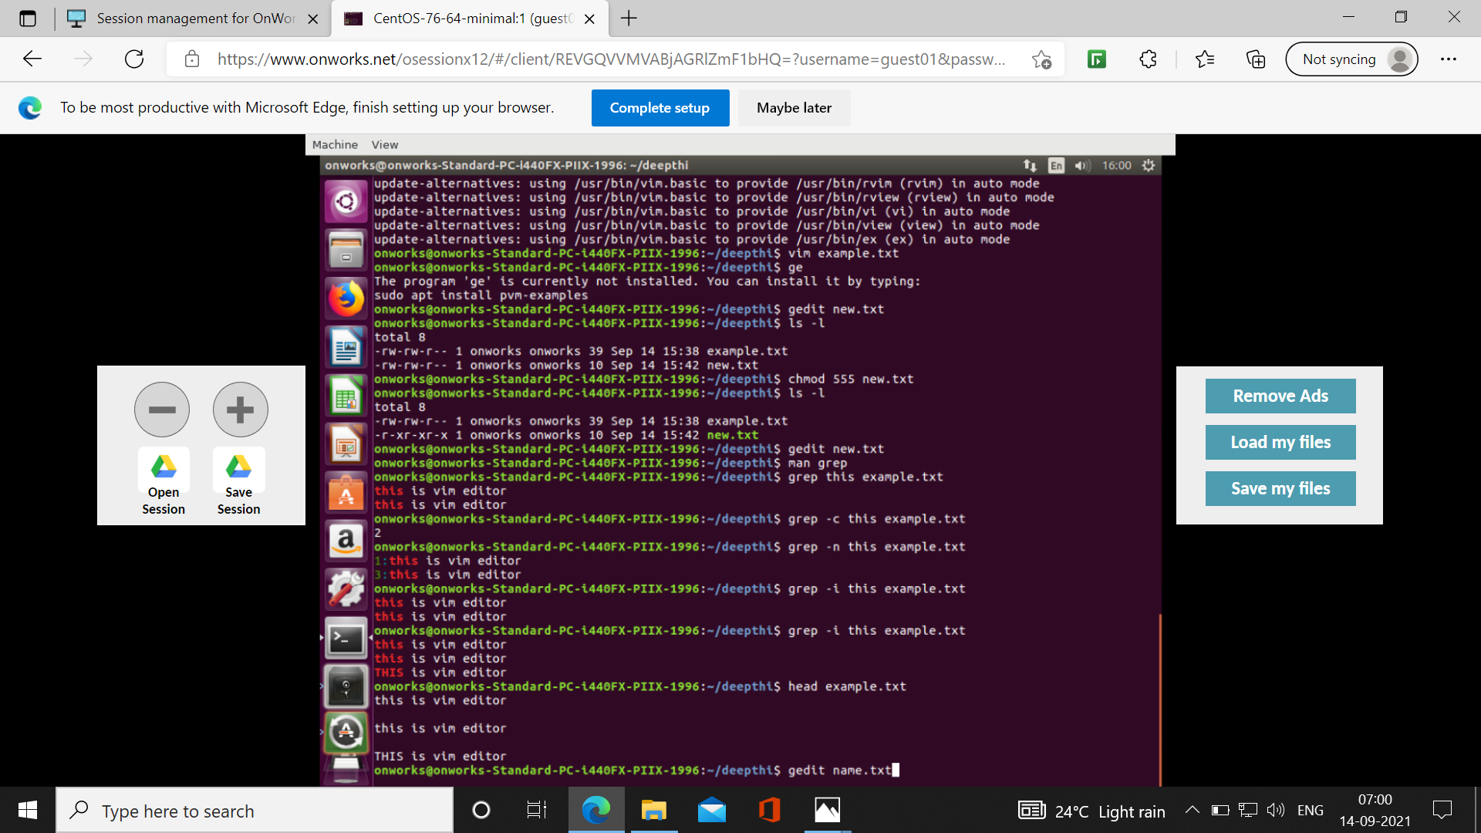

Slide 25
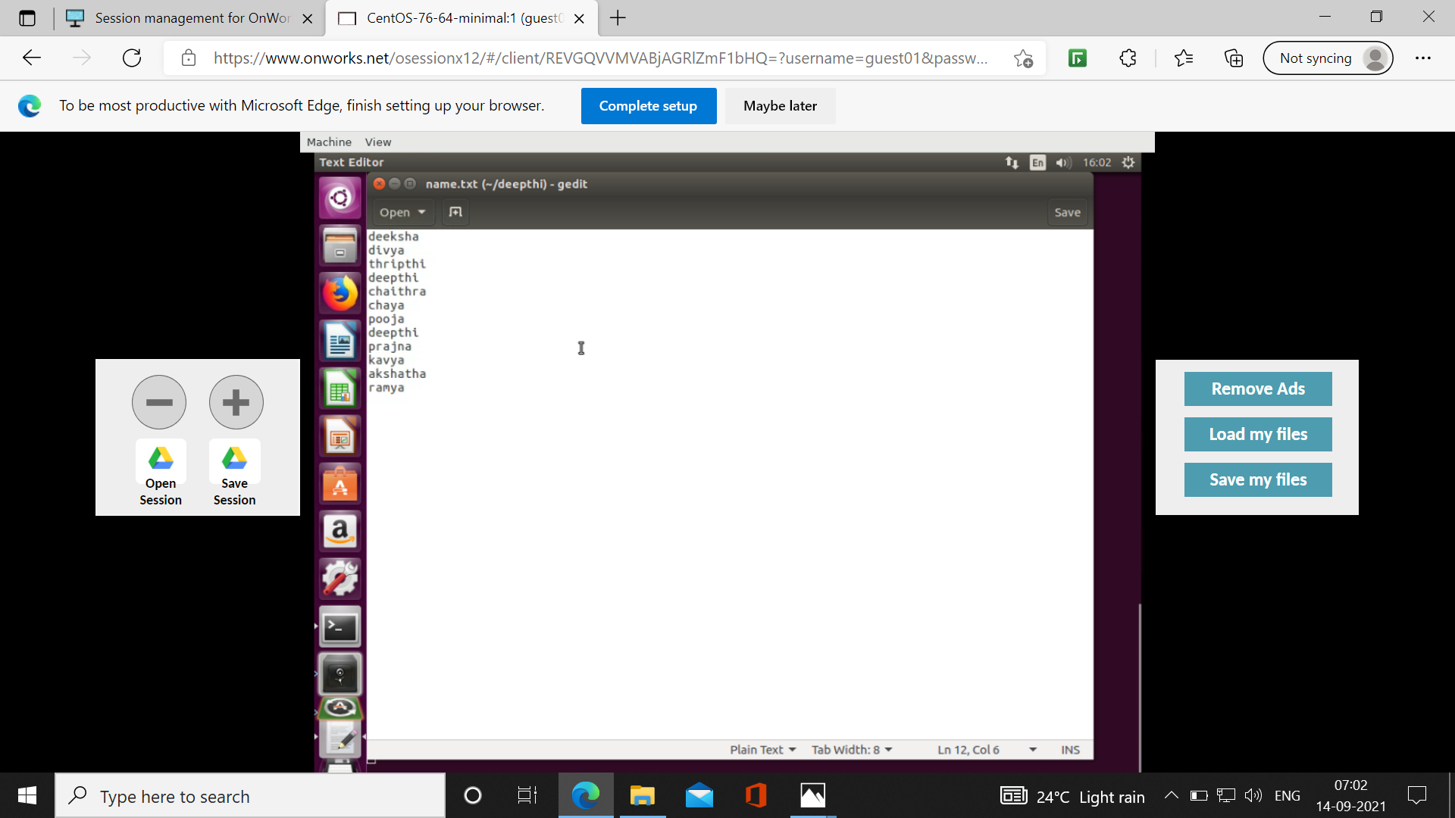

Slide 26
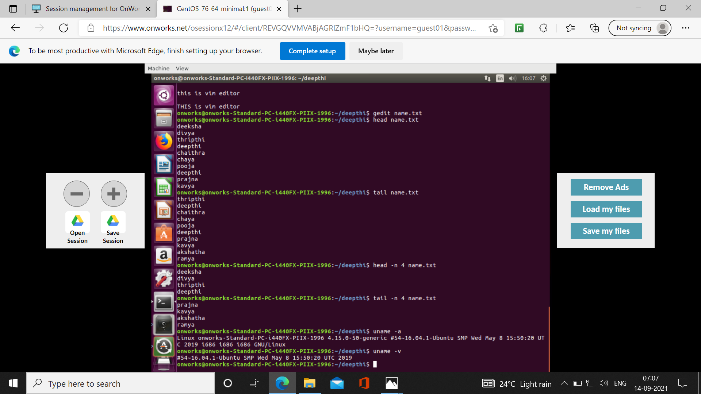

Slide 27
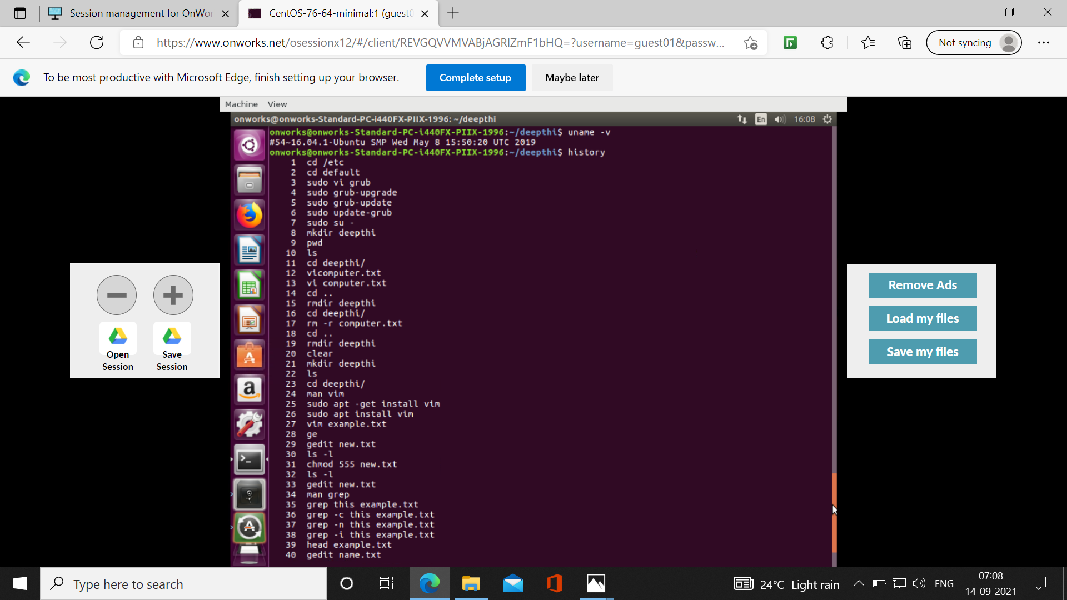

Slide 28
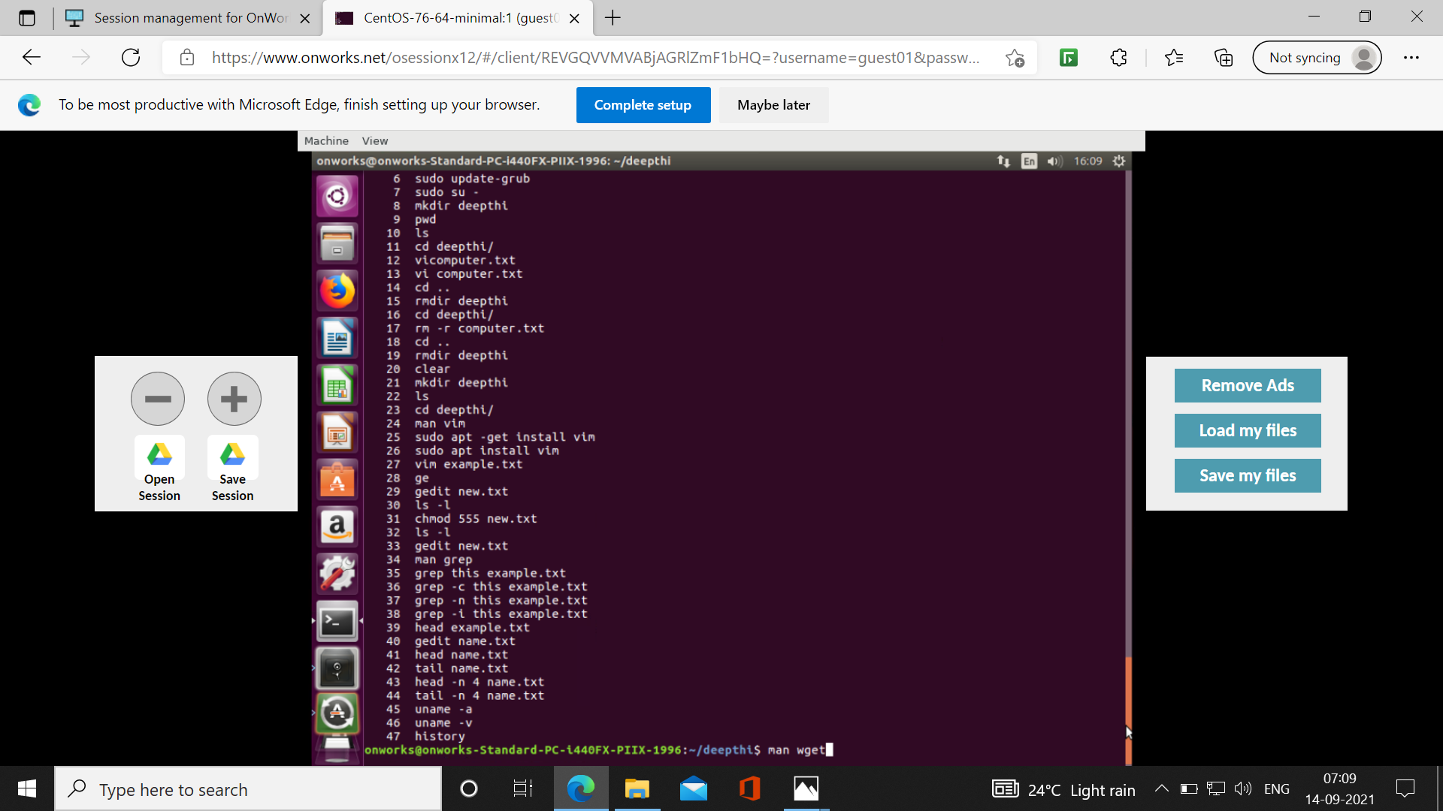

Slide 29
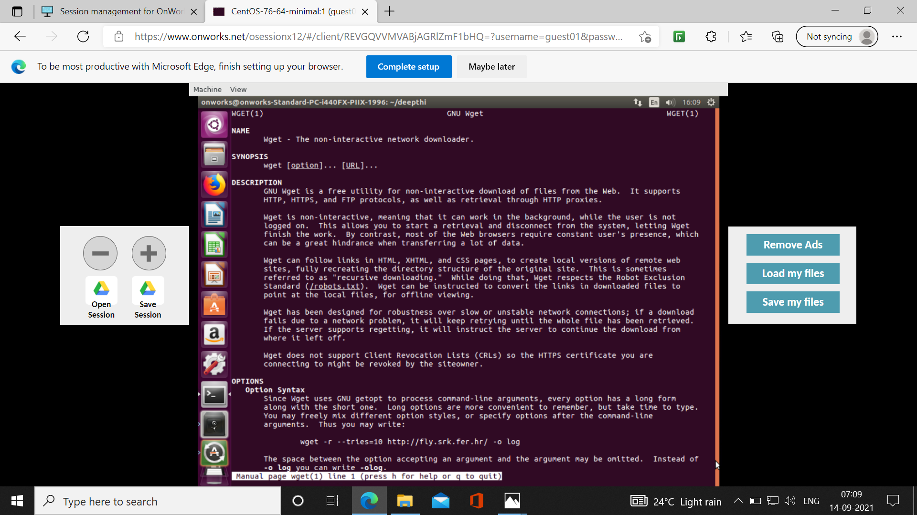

Slide 30
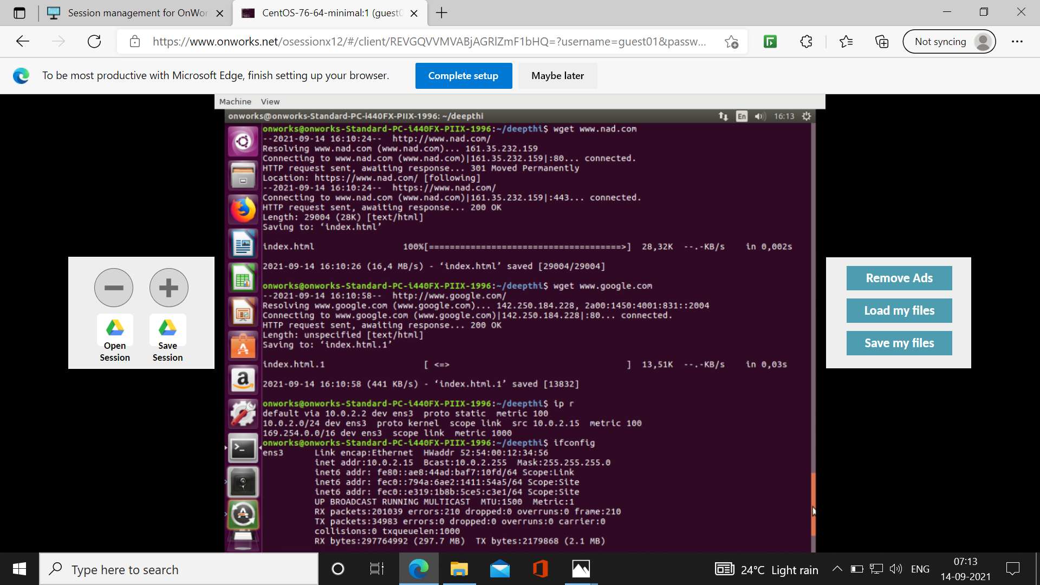

Slide 31
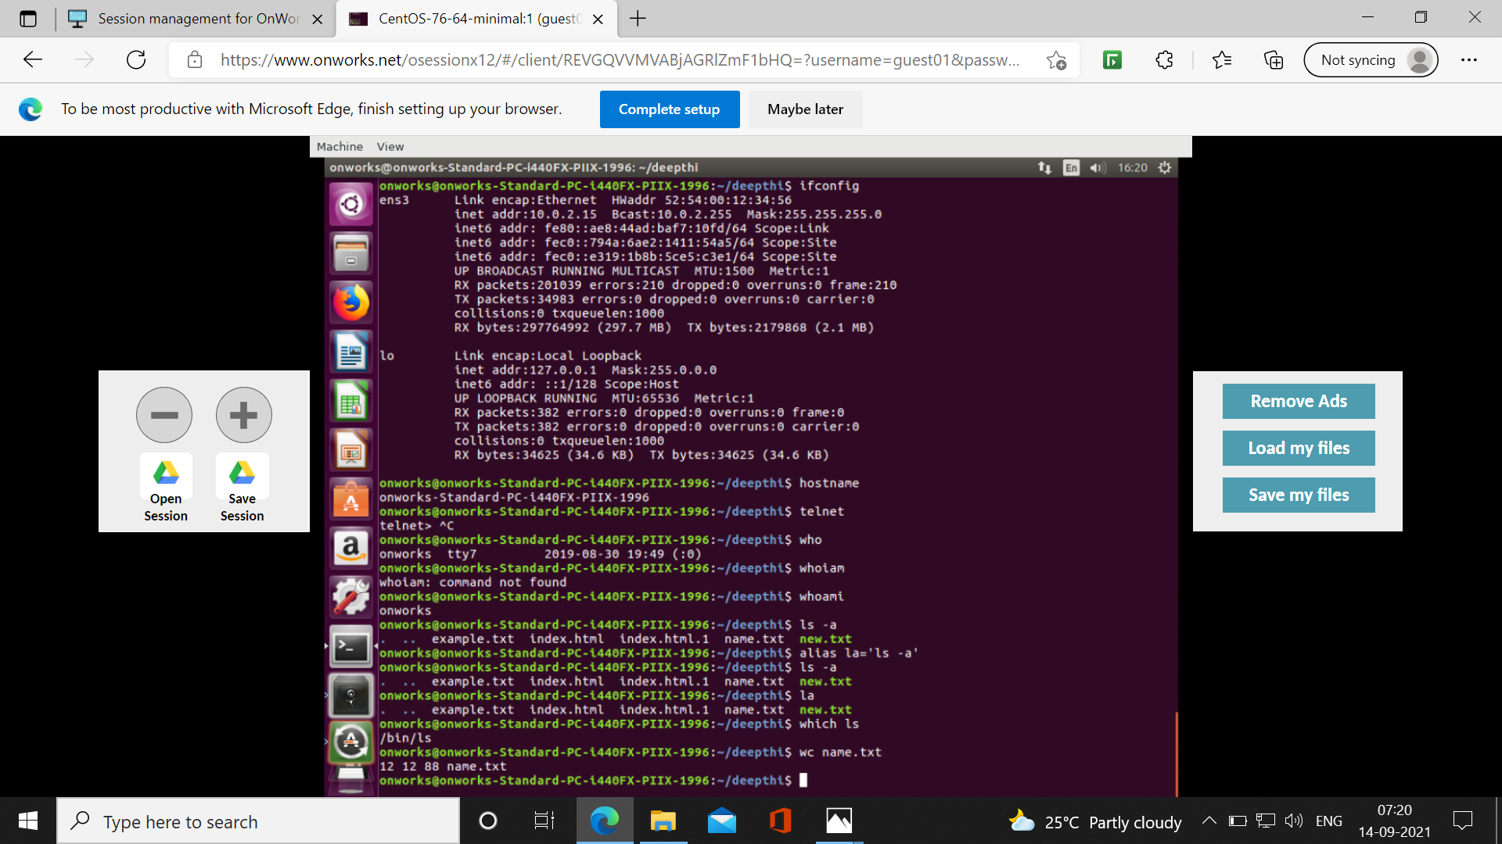

Slide 32
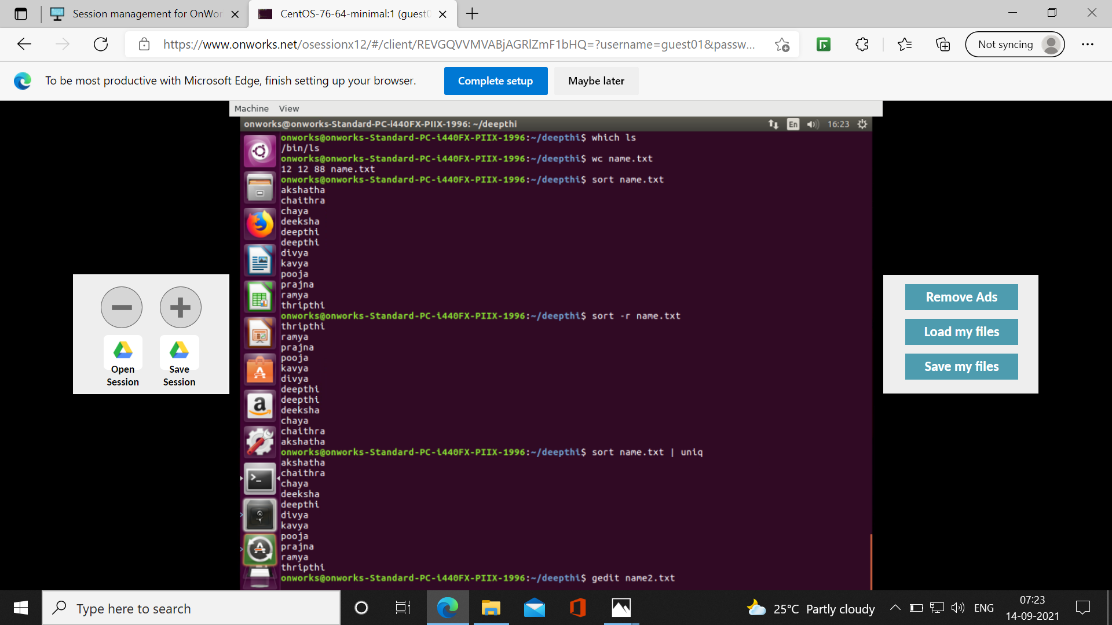

Slide 33
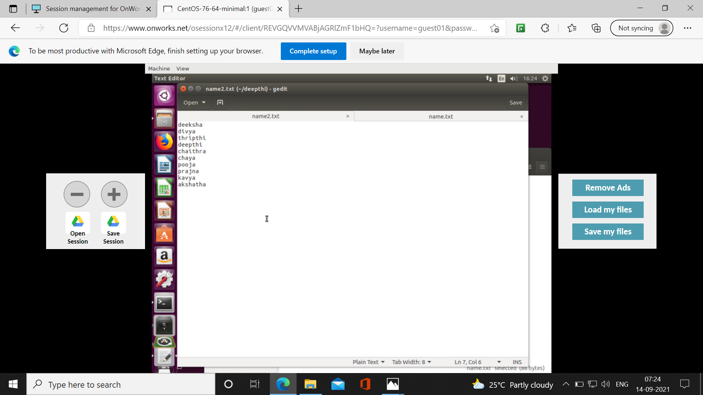

Slide 34
